Slide 1
Knowledge Discovery Game
User Guide

Slide 2
Knowledge Discovery Game is licensed under a Creative Commons Attribution-ShareAlike 4.0 International License. Customisation is encouraged!

Slide 3
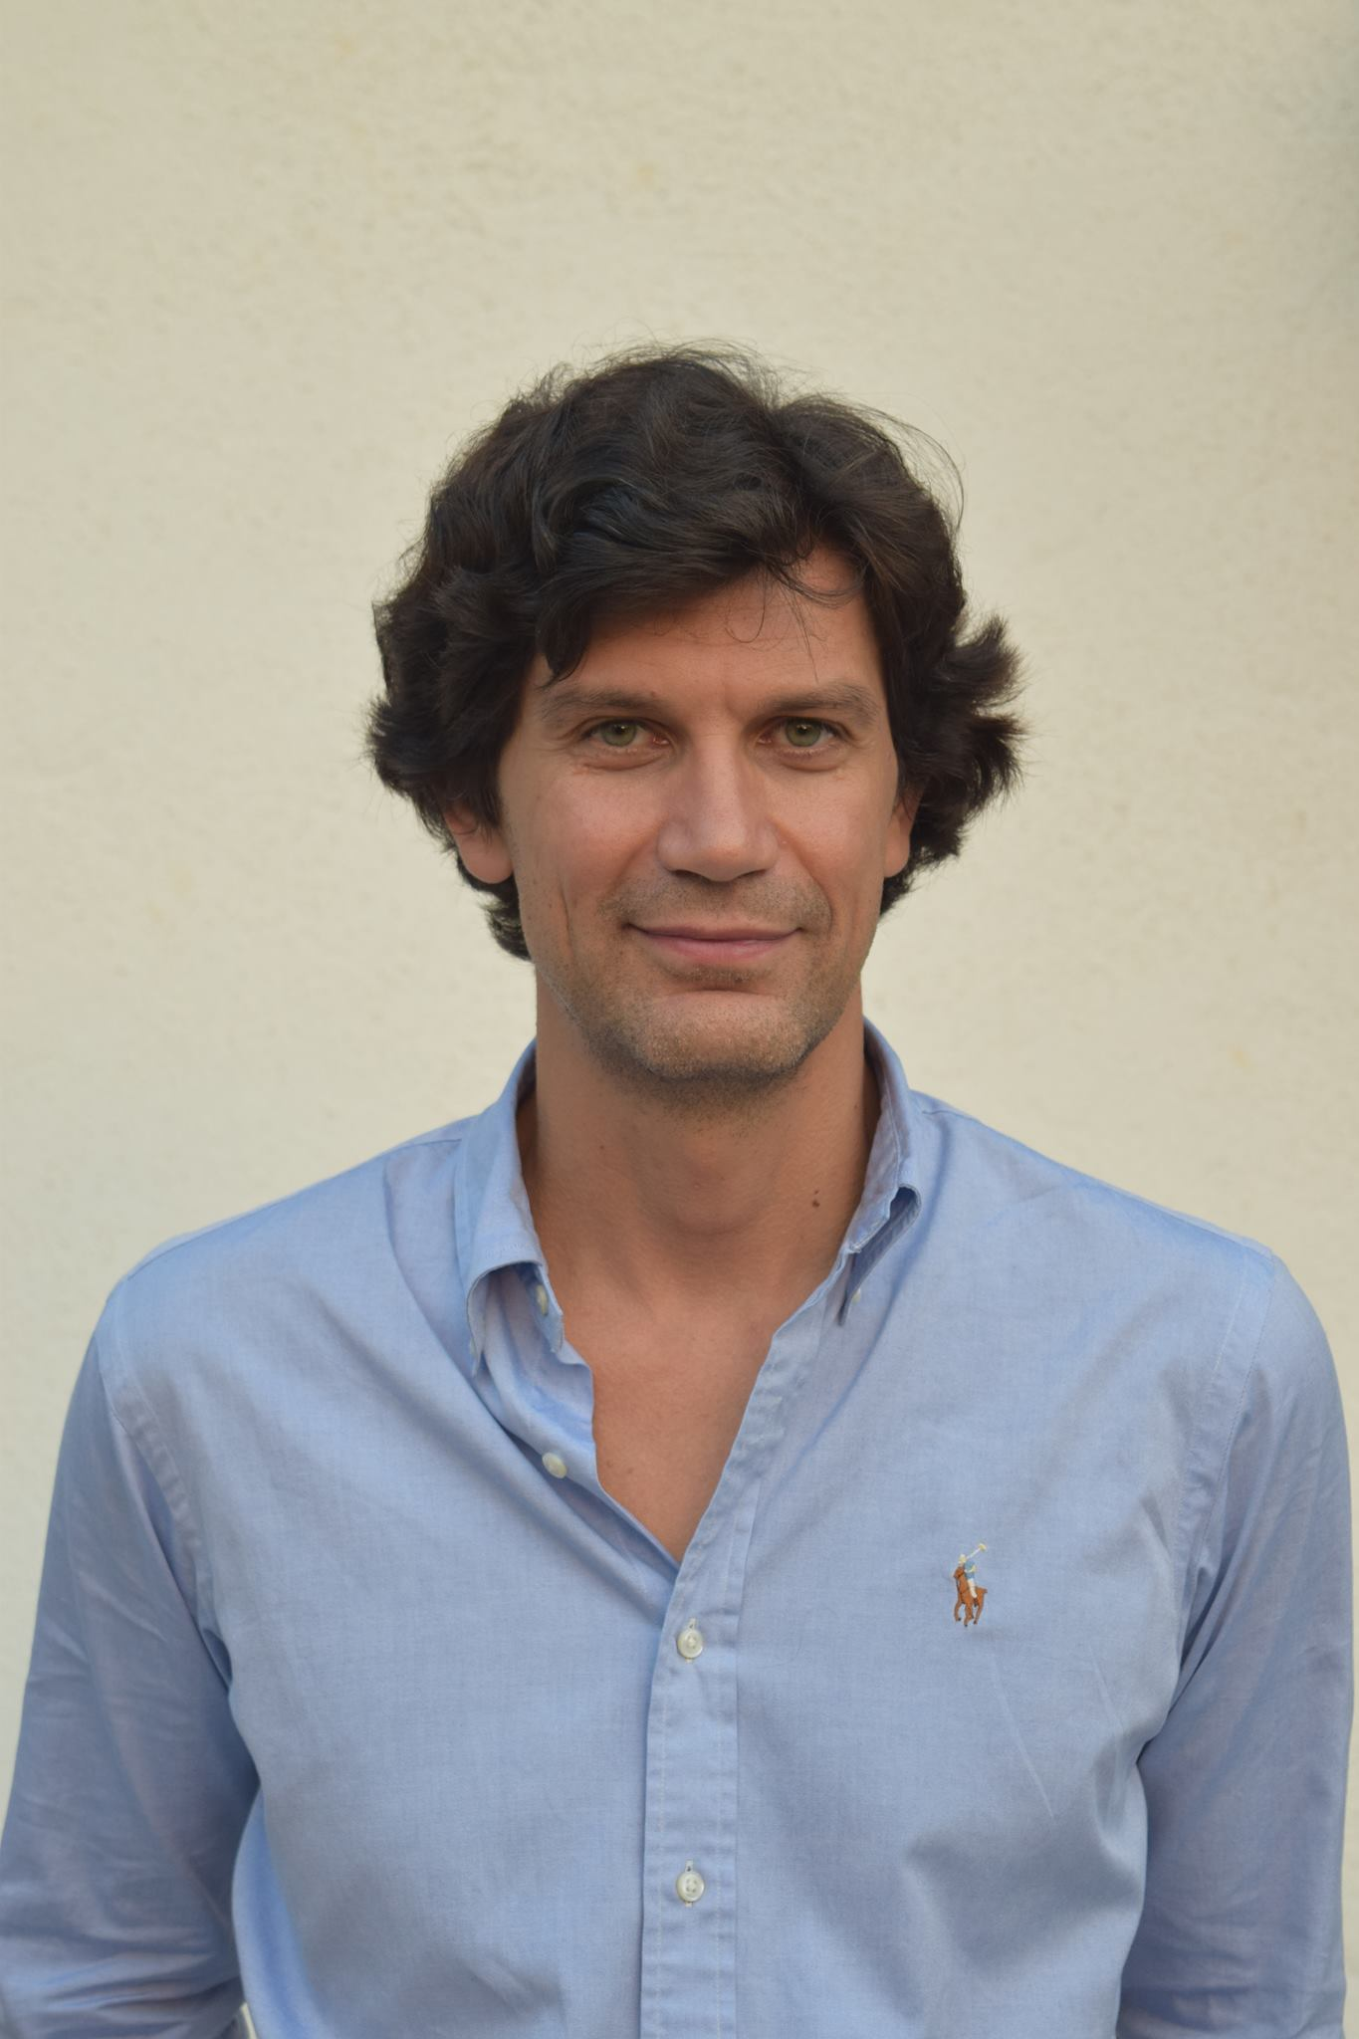
Dimitar Bakardzhiev is an expert in managing successful and cost-effective technology development. With his blend of technical, managerial and operational expertise, he effectively combines the theory and practice of Agile and Kanban Method to deliver business results.
As a Kanban trainer, coach, expert Kanban practitioner and Brickell Key Award 2015 Finalist, Dimitar puts lean principles to work every day when managing complex software projects.
Dimitar has published David Anderson’s Kanban book as well as books on Lean, Theory of Constraints by Goldratt and Deming's Theory of Management in the Bulgarian language.
@dimiterbak

Slide 4
The goal of the Knowledge Discovery Game is to let people understand a knowledge discovery process.

Slide 5
Learning outcomes
People feel happy when the knowledge needed to e discovered is minimised.
A them is most productive then the average Knowledge Discovery Efficiency (KEDE) is maximised.
It is possible to measure if people felt happy and were productive.

Slide 6
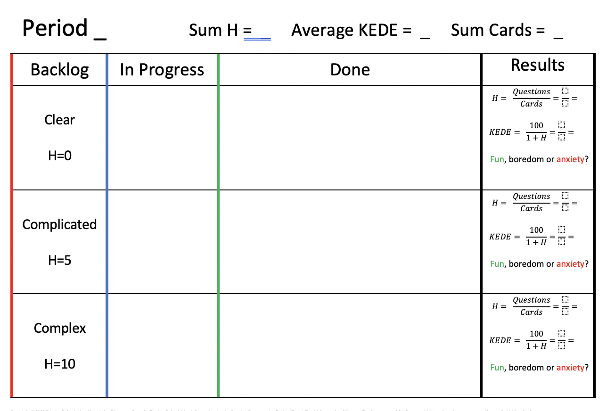

Slide 7

If you are missing information…

Slide 8
Roles
Team member. Starts, moves and completes work items.
Novice, existing knowledge H=1
Competent, existing knowledge H=4
Expert, existing knowledge H=9

Slide 9
Setup (for each period)
Get into teams of 3 people.
Each team member to pick a role.
Arrange a backlog of:
10 clear features
10 complicated features
10 complex features
Leave the cards in their section of “Backlog” column.
Assign who will be working on what type of feature.

Slide 10
Rules
You as a team have 10 days to finish 30 cards. Each day begins with a “daily meeting”. In your “daily meeting” each of the team members should follow the rules:
Do you have a card In Progress?
If Yes then
Acquire missing information from Google
Cross the dots per the information you just acquired
If No then
Start a new card,
Check if you have the knowledge needed (existing + discovered)?
If Yes then
move the in Progress card into Done column
If No then
Leave the card in Progress

Slide 11
Daily routine
Do you have
a card in
Progress?
New day
Do you
have the
Knowledge?
No
Yes
Google It
Cross
the dots
Move
the card to
Done
Yes
Leave
the card in
Progress
No
Mark your existing knowledge
Start
new card
End of
Day

Slide 12
After the game
Write into Done the number of cards delivered
Calculate Sum H, Average KEDE and Sum Cards
Answer how you felt while doing the activity by marking one of:
Fun,
boredom or
anxiety?

Slide 13
Debrief
In your teams, list and prepare to report back:
Concepts, practices, and outcomes simulated in the game
Your observations
Workplace parallels

Slide 14
Period 1
Existing knowledge |  | Missing information
Novice | 1 | Complex | 10
Competent | 4 | Complicated | 5
Expert | 9 | Clear | 0

Slide 15
Period 2
Existing knowledge |  | Missing information
Novice | 1 | Clear | 0
Competent | 4 | Complicated | 5
Expert | 9 | Complex | 10

Slide 16
Period 3
Existing knowledge |  | Missing information
Novice | 1 | Complicated | 5
Competent | 4 | Clear | 0
Expert | 9 | Complex | 10

Slide 17
Results from the game
Happiness |  |  | Productivity
Sum H | Avg H | Avg KEDE | Sum Cards
10 | 0,875 | 53 | 16
5 | 0,76 | 56 | 17
2 | 0,5 | 66 | 20

Slide 18
Discussion
Simulation results

Slide 19
KEDE correlates with happiness & productivity
Happiness |  |  | Productivity
Sum H | Avg H | Avg KEDE | Sum Cards
10 | 0,875 | 53 | 16
5 | 0,76 | 56 | 17
2 | 0,5 | 66 | 20

Slide 20

We can use Knowledge Discovery Efficiency (KEDE) to quantify the balance between individual capability and work complexity.

Slide 21
The mismatch between capabilities and challenges is considered as an abuse of the person and the organization.

Slide 22
Types of abuse
Misuse - when the work to be done outstrips what a person feels able to do;
Disuse - when what there is to do fails to challenge what a person feels capable of doing. As an example, micro-management leads to bored employees at the lower levels when their capabilities are underutilized.

Slide 23

That abuse means:
Underutilized and wasted human potential.

Slide 24
“System is not a sum of the behavior of its parts, it’s the product of their interactions.”
Russell L. Ackoff (1994)
https://www.youtube.com/watch?v=OqEeIG8aPPk
An event hosted by Clare Crawford-Mason and Lloyd Dobyns
to capture the Learning and Legacy of Dr. W. Edwards Deming.
Notes:
https://www.youtube.com/watch?v=OqEeIG8aPPk

Slide 25
“The goal is to make full use of the workers’ capabilities by building up a system that will allow the workers to display their full capabilities by themselves.”
Y. SUGIMORI, K. KUSUNOKI, F. CHO & S. UCHIKAWA (1977)
Toyota production system and Kanban system

Slide 26
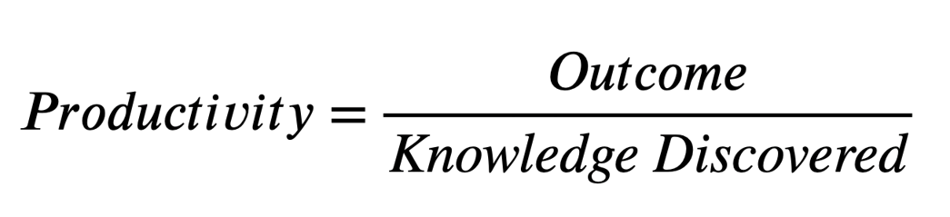
Notes:
Software developers apply knowledge in order to deliver outcomes. If they don't have the knowledge needed they have to discover it. Existing knowledge is the easiest and the fastest to discover - it is in the head, one just applies it. In other words, when existing knowledge is applied then there is the most efficient knowledge discovery. Conversely, when a lot of knowledge is missing then the knowledge discovery is less efficient. The more existing knowledge was applied i.e. the less knowledge was missing for achieving the desired outcome the more efficient the software development process is.

Slide 27
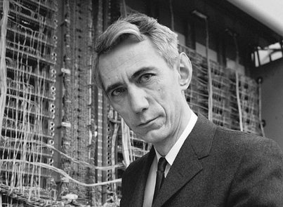
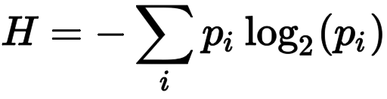
“Missing information” is studied by the Information Theory
Claude Shannon (1916-2001)
Notes:
“Missing information” is studied by the Information Theory.
Shannon.’s formula calculates the missing information H as ….

Slide 28
Missing information equals the average number of
“Yes/No” binary questions
we need to ask in order to gain the knowledge needed.
Notes:
Missing information equals the average number of “Yes/No” binary questions we need to ask in order to gain the knowledge needed.

Slide 29
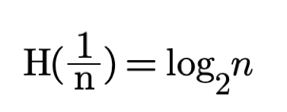
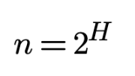
Perplexity
Questions | Perplexity
0 | 1
4 | 16
6 | 64
99 | 6x10²⁹
Notes:
To put it in context - there are something like 10²² to 10²⁴ stars in the Universe[3]. We may safely say that the knowledge worker faced an unbearable perplexity.

Slide 30
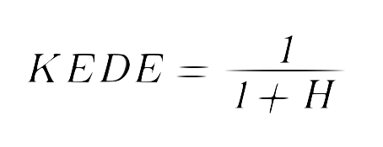
Knowledge Discovery Efficiency (KEDE)
KEDE is a ratio between
the knowledge discovered and
the maximum amount of knowledge
that could possibly be discovered
for a time period.
Notes:
We measure the capability of software development organisations, using the scientifically backed and patented metric ! Knowledge Discovery Efficiency or KEDE.
KEDE reflects the capability of software developers to efficiently discover and apply knowledge.

Slide 31
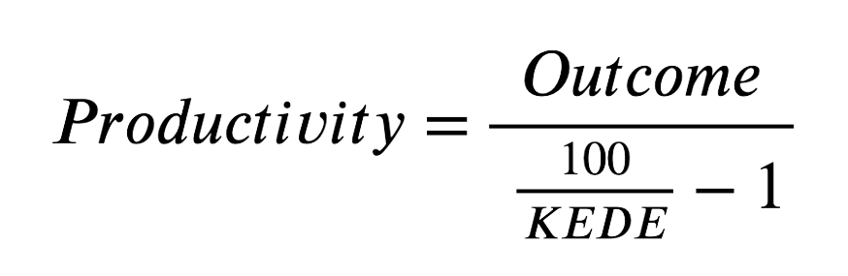
Notes:
Now we can rewrite the productivity formula for software developers to have KEDE in the denominator.
For example, if we have an outcome of $100,000 and KEDE of 2, then productivity will be $2048 per bit of information. On another hand, if we have the same outcome of $100,000, but this time KEDE is 20, then productivity will be $25,000 per bit of information. We see the disproportionately positive effect of having experts on the team.

Slide 32
List your conclusions
Work

